Slide 1
Artificial Intelligence Informed Search

Slide 2
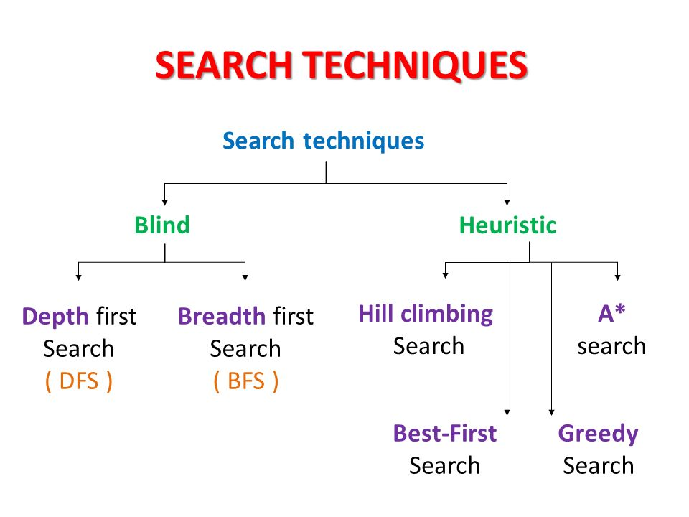
(uninformed Search)
(Informed Search)
Other blind search strategies are:
Depth-limited search (Extended DFS)
Iterative-deepening search (Extended DFS)
Uniform cost search
Bi-directional search

Slide 3
Uninformed Vs Informed Search
Uninformed search: Use only the information available in the problem definition. Example: breadth-first, depth-first, depth limited, iterative deepening, uniform cost and bidirectional search
Informed search: Use domain knowledge or heuristic to choose the best move. Example. Greedy best-first, A*, IDA*, and beam search

Slide 4
Using problem specific knowledge to aid searching
With knowledge, one can search the state space as if he was given “hints” when exploring a maze.
Heuristic information in search = Hints
Leads to dramatic speed up in efficiency.
A
B
C
D
E
Search only in this subtree!!
F
G
H
I
J
K
L
M
N
O

Slide 5
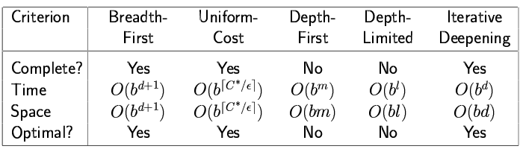
More formally, why heuristic functions work?
In any search problem where there are at most b choices at each node and a depth of d at the goal node, a naive search algorithm would have to, in the worst case, search around O(b^{d}) nodes before finding a solution (Exponential Time Complexity).
Heuristics improve the efficiency of search algorithms by reducing the effective branching factor from b to (ideally) a low constant b* such that
1 =< b* << b

Slide 6
Heuristic Functions
A heuristic function is a function h(n) that gives an estimation on the “cost” of getting from node n to the goal state – so that the node with the least cost among all possible choices can be selected for expansion first. An evaluation function f(n) can use h(n) to define the goodness of a state
Three approaches to defining f:
f measures the value of the current state (its “goodness”)
f measures the estimated cost of getting to the goal from the current state:
f(n) = h(n) where h(n) = an estimate of the cost to get from n to a goal
f measures the estimated cost of getting to the goal state from the current state and the cost of the existing path to it. Often, in this case, we decompose f:
f(n) = g(n) + h(n) where g(n) = the cost to get to n (from initial state)

Slide 7
Approach 1: f Measures the Value of the Current State
Usually the case when solving optimization problems
Finding a state such that the value of the metric f is optimized
Often, in these cases, f could be a weighted sum of a set of component values:
N-Queens
Example: the number of queens under attack …
Data mining
Example: the “predictive-ness” (a.k.a. accuracy) of a rule discovered

Slide 8
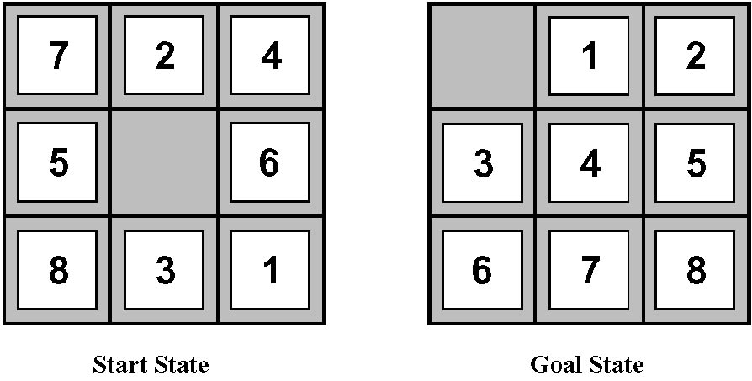
Approach 2: f Measures the Cost to the Goal
A state X would be better than a state Y if the estimated cost of getting from X to the goal is lower than that of Y – because X would be closer to the goal than Y
8–Puzzle
h₁: The number of misplaced tiles (squares with number).
h₂: The sum of the distances of the tiles from their goal positions.

Slide 9
Approach 3: f measures the total cost of the solution path (With Admissible Heuristic Functions)
A heuristic function is admissible if h(n) never overestimates the cost to reach the goal.
Admissible heuristics are “optimistic”: “the cost is not that much …”
However, g(n) is the exact cost to reach node n from the initial state.
Therefore, f(n) never over-estimate the true cost to reach the goal state through node n.
Theorem: A search is optimal if h(n) is admissible.
I.e. The search using h(n) returns an optimal solution.
Given h₂(n) > h₁(n) for all n, it’s always more efficient to use h₂(n).
h₂ is more realistic than h₁ (more informed), though both are optimistic.

Slide 10
Traditional informed search strategies
Greedy Best first search
“Always chooses the successor node with the best f value” where f(n) = h(n)
We choose the one that is nearest to the final state among all possible choices
A* search
Best first search using an evaluation function f that takes into account the “admissible” heuristic function h and the current cost g
Always returns the optimal solution path

Slide 11
Informed Search Strategies
Best First Search

Slide 12
An implementation of Best First Search
function BEST-FIRST-SEARCH (problem, eval-fn)
returns a solution sequence, or failure
queuing-fn = a function that sorts nodes by eval-fn
return GENERIC-SEARCH (problem,queuing-fn)

Slide 13
Informed Search Strategies
Greedy Search
eval-fn: f(n) = h(n)

Slide 14
Greedy Search
Start
A
State | Heuristic: h(n)
A | 366
B | 374
C | 329
D | 244
E | 253
F | 178
G | 193
H | 98
I | 0
118
75
140
B
C
111
E
D
80
99
G
F
97
H
211
101
I
Goal
f(n) = h (n) = straight-line distance heuristic

Slide 15
Greedy Search
Start
State | Heuristic: h(n)
A | 366
B | 374
C | 329
D | 244
E | 253
F | 178
G | 193
H | 98
I | 0
A
75
118
140
B
C
111
E
D
80
99
G
F
97
H
211
101
I
Goal
f(n) = h (n) = straight-line distance heuristic

Slide 16
Greedy Search
Start
State | Heuristic: h(n)
A | 366
B | 374
C | 329
D | 244
E | 253
F | 178
G | 193
H | 98
I | 0
A
75
118
140
B
C
111
E
D
80
99
G
F
97
H
211
101
I
Goal
f(n) = h (n) = straight-line distance heuristic

Slide 17
Greedy Search
Start
State | Heuristic: h(n)
A | 366
B | 374
C | 329
D | 244
E | 253
F | 178
G | 193
H | 98
I | 0
A
75
118
140
B
C
111
E
D
80
99
G
F
97
H
211
101
I
Goal
f(n) = h (n) = straight-line distance heuristic

Slide 18
Greedy Search
Start
State | Heuristic: h(n)
A | 366
B | 374
C | 329
D | 244
E | 253
F | 178
G | 193
H | 98
I | 0
A
75
118
140
B
C
111
E
D
80
99
G
F
97
H
211
101
I
Goal
f(n) = h (n) = straight-line distance heuristic

Slide 19
Greedy Search
Start
State | Heuristic: h(n)
A | 366
B | 374
C | 329
D | 244
E | 253
F | 178
G | 193
H | 98
I | 0
A
75
118
140
B
C
111
E
D
80
99
G
F
97
H
211
101
I
Goal
f(n) = h (n) = straight-line distance heuristic

Slide 20
Greedy Search
Start
State | Heuristic: h(n)
A | 366
B | 374
C | 329
D | 244
E | 253
F | 178
G | 193
H | 98
I | 0
A
75
118
140
B
C
111
E
D
80
99
G
F
97
H
211
101
I
Goal
f(n) = h (n) = straight-line distance heuristic

Slide 21
Greedy Search
Start
State | Heuristic: h(n)
A | 366
B | 374
C | 329
D | 244
E | 253
F | 178
G | 193
H | 98
I | 0
A
75
118
140
B
C
111
E
D
80
99
G
F
97
H
211
101
I
Goal
f(n) = h (n) = straight-line distance heuristic

Slide 22
Greedy Search
Start
State | Heuristic: h(n)
A | 366
B | 374
C | 329
D | 244
E | 253
F | 178
G | 193
H | 98
I | 0
A
75
118
140
B
C
111
E
D
80
99
G
F
97
H
211
101
I
Goal
f(n) = h (n) = straight-line distance heuristic

Slide 23
Greedy Search
Start
State | Heuristic: h(n)
A | 366
B | 374
C | 329
D | 244
E | 253
F | 178
G | 193
H | 98
I | 0
A
75
118
140
B
C
111
E
D
80
99
G
F
97
H
211
101
I
Goal
f(n) = h (n) = straight-line distance heuristic

Slide 24
Greedy Search: Tree Search
Start
A

Slide 25
Greedy Search: Tree Search
Start
A
75
118
[329]
140
[374]
B
C
[253]
E

Slide 26
Greedy Search: Tree Search
Start
A
75
118
[329]
140
[374]
B
C
[253]
E
80
99
[193]
[178]
G
F
[366]
A

Slide 27
Greedy Search: Tree Search
Start
A
75
118
[329]
140
[374]
B
C
[253]
E
80
99
[193]
[178]
G
F
[366]
A
211
[253]
I
[0]
E
Goal

Slide 28
Greedy Search: Tree Search
Start
A
75
118
[329]
140
[374]
B
C
[253]
E
80
99
[193]
[178]
G
F
[366]
A
211
[253]
I
[0]
E
Goal
Heuristic(A-E-F-I) = 253 + 178 + 0 = 431
dist(A-E-F-I) = 140 + 99 + 211 = 450

Slide 29
Greedy Search: Optimal ?
Start
State | Heuristic: h(n)
A | 366
B | 374
C | 329
D | 244
E | 253
F | 178
G | 193
H | 98
I | 0
A
75
118
140
B
C
111
E
D
80
99
G
F
97
H
211
101
I
Goal
f(n) = h (n) = straight-line distance heuristic
dist(A-E-G-H-I) =140+80+97+101=418

Slide 30
Greedy Search: Complete ?
Start
State | Heuristic: h(n)
A | 366
B | 374
** C | 250
D | 244
E | 253
F | 178
G | 193
H | 98
I | 0
A
75
118
140
B
C
111
E
D
80
99
G
F
97
H
211
101
I
Goal
f(n) = h (n) = straight-line distance heuristic

Slide 31
Greedy Search: Tree Search
Start
A

Slide 32
Greedy Search: Tree Search
Start
A
75
118
[250]
140
[374]
B
C
[253]
E

Slide 33
Greedy Search: Tree Search
Start
A
75
118
[250]
140
[374]
B
C
[253]
E
111
[244]
D

Slide 34
Greedy Search: Tree Search
Start
A
75
118
[250]
140
[374]
B
C
[253]
E
111
[244]
D
Infinite Branch !
[250]
C

Slide 35
Greedy Search: Tree Search
Start
A
75
118
[250]
140
[374]
B
C
[253]
E
111
[244]
D
Infinite Branch !
[250]
C
[244]
D

Slide 36
Greedy Search: Tree Search
Start
A
75
118
[250]
140
[374]
B
C
[253]
E
111
[244]
D
Infinite Branch !
[250]
C
[244]
D

Slide 37
Greedy Search: Time and Space Complexity ?
Start
A
75
Greedy search is not optimal.
Greedy search is incomplete without systematic checking of repeated states.
In the worst case, the Time and Space Complexity of Greedy Search are both O(b^{m})
Where b is the branching factor and m the maximum path length
118
140
B
C
111
E
D
80
99
G
F
97
H
211
101
I
Goal

Slide 38
Informed Search Strategies
A* Search
eval-fn: f(n)=g(n)+h(n)

Slide 39
A* (A Star)
Greedy Search minimizes a heuristic h(n) which is an estimated cost from a node n to the goal state. Greedy Search is efficient but it is not optimal nor complete.
Uniform Cost Search minimizes the cost g(n) from the initial state to n. UCS is optimal and complete but not efficient.
New Strategy: Combine Greedy Search and UCS to get an efficient algorithm which is complete and optimal.

Slide 40
A* (A Star)
A* uses an evaluation function which combines g(n) and h(n): f(n) = g(n) + h(n)
g(n) is the exact cost to reach node n from the initial state.
h(n) is an estimation of the remaining cost to reach the goal.

Slide 41
A* (A Star)
g(n)
f(n) = g(n)+h(n)
n
h(n)

Slide 42
A* Search
Start
State | Heuristic: h(n)
A | 366
B | 374
C | 329
D | 244
E | 253
F | 178
G | 193
H | 98
I | 0
A
75
118
140
B
C
111
E
D
80
99
G
F
97
H
211
101
I
Goal
f(n) = g(n) + h (n)
g(n): is the exact cost to reach node n from the initial state.

Slide 43
A* Search: Tree Search
A
Start

Slide 44
A* Search: Tree Search
A
Start
118
75
140
E
[393]
B
[449]
[447]
C

Slide 45
A* Search: Tree Search
A
Start
118
75
140
E
[393]
B
[449]
[447]
C
80
99
[413]
G
F
[417]

Slide 46
A* Search: Tree Search
A
Start
118
75
140
E
[393]
B
[449]
[447]
C
80
99
[413]
G
F
[417]
97
[415]
H

Slide 47
A* Search: Tree Search
A
Start
118
75
140
E
[393]
B
[449]
[447]
C
80
99
[413]
G
F
[417]
97
[415]
H
101
I
[418]
Goal

Slide 48
A* Search: Tree Search
A
Start
118
75
140
E
[393]
B
[449]
[447]
C
80
99
[413]
G
F
[417]
97
[415]
H
I
[450]
101
I
[418]
Goal

Slide 49
A* Search: Tree Search
A
Start
118
75
140
E
[393]
B
[449]
[447]
C
80
99
[413]
G
F
[417]
97
[415]
H
I
[450]
101
I
[418]
Goal

Slide 50
A* Search: Tree Search
A
Start
118
75
140
E
[393]
B
[449]
[447]
C
80
99
[413]
G
F
[417]
97
[415]
H
I
[450]
101
I
[418]
Goal

Slide 51
Optimality of A* search
Tree search of A* is optimal if the heuristic is admissible
Graph search of A* is optimal if the heuristic is consistent

Slide 52
Admissible heuristics
A heuristic h(n) is admissible if for every node n,
h(n) ≤ h*(n), where h*(n) is the true cost to reach the goal state from n.
An admissible heuristic never overestimates the cost to reach the goal, i.e., it is optimistic
Example: h_{SLD}(n) (never overestimates the actual road distance)
Theorem: If h(n) is admissible, A* using TREE-SEARCH is optimal

Slide 53
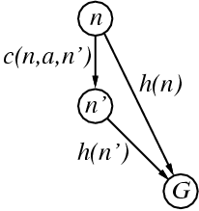
Consistent heuristics
A heuristic is consistent if for every node n, every successor n' of n generated by any action a, follows the triangular inequality.
h(n) ≤ c(n,a,n’) + h(n’)
If h is consistent, we have f(n') = g(n') + h(n')
= g(n) + c(n,a,n') + h(n')
≥ g(n) + h(n)
= f(n)
i.e., f(n) is non-decreasing along any path.
Theorem: If h(n) is consistent, A* using GRAPH-SEARCH is optimal

Slide 54
What if heuristic is NOT Admissible?
h() overestimates the cost to reach the goal state

Slide 55
A* Search: what if h is not admissible !
Start
State | Heuristic: h(n)
A | 366
B | 374
C | 329
D | 244
E | 253
F | 178
G | 193
H | 138
I | 0
A
75
118
140
B
C
111
E
D
80
99
G
F
97
H
211
101
I
f(n) = g(n) + h (n) – (H-I) Overestimated
g(n): is the exact cost to reach node n from the initial state.
Goal

Slide 56
A* Search: Tree Search
A
Start

Slide 57
A* Search: Tree Search
A
Start
118
75
140
E
[393]
B
[449]
[447]
C

Slide 58
A* Search: Tree Search
A
Start
118
75
140
E
[393]
B
[449]
[447]
C
80
99
[413]
G
F
[417]

Slide 59
A* Search: Tree Search
A
Start
118
75
140
E
[393]
B
[449]
[447]
C
80
99
[413]
G
F
[417]
97
[455]
H

Slide 60
A* Search: Tree Search
A
Start
118
75
140
E
[393]
B
[449]
[447]
C
80
99
[413]
G
F
[417]
97
[455]
Goal
H
I
[450]

Slide 61
A* Search: Tree Search
A
Start
118
75
140
E
[393]
B
[449]
[447]
C
80
99
[473]
[413]
G
F
[417]
D
97
[455]
Goal
H
I
[450]

Slide 62
A* Search: Tree Search
A
Start
118
75
140
E
[393]
B
[449]
[447]
C
80
99
[473]
[413]
G
F
[417]
D
97
[455]
Goal
H
I
[450]

Slide 63
A* Search: Tree Search
A
Start
118
75
140
E
[393]
B
[449]
[447]
C
80
99
[473]
[413]
G
F
[417]
D
97
[455]
Goal
H
I
[450]

Slide 64
A* Search: Tree Search
A
Start
118
75
140
E
[393]
B
[449]
[447]
C
80
99
[473]
[413]
G
F
[417]
D
97
[455]
Goal
H
I
[450]
Not optimal !!! (better path is A -> E -> G -> H -> I

Slide 65
A* Algorithm
A* with systematic checking for repeated states …

Slide 66
A* Algorithm
1. Search queue Q is empty.
2. Place the start state s in Q with f value h(s).
3. If Q is empty, return failure.
4. Take node n from Q with lowest f value.
(Keep Q sorted by f values and pick the first element).
5. If n is a goal node, stop and return solution.
6. Generate successors of node n.
7. For each successor n’ of n do:
a) Compute f(n’) = g(n) + cost(n,n’) + h(n’).
b) If n’ is new (never generated before), add n’ to Q.
c) If node n’ is already in Q with a higher f value, replace it with current f(n’) and place it in sorted order in Q.
End for
8. Go back to step 3.

Slide 67
A* Search: Analysis
A* is complete except if there is an infinity of nodes with f < f(G).
A* is optimal if heuristic h is admissible.
Time complexity depends on the quality of heuristic but is still exponential.
For space complexity, A* keeps all nodes in memory. A* has worst case O(b^{d}) space complexity, but an iterative deepening version is possible (IDA*).
Start
A
75
118
140
B
C
111
E
D
80
99
G
F
97
H
211
101
I
Goal

Slide 68
When to Use Search Techniques
The search space is small, and
There are no other available techniques, or
It is not worth the effort to develop a more efficient technique
The search space is large, and
There is no other available techniques, and
There exist “good” heuristics

Slide 69
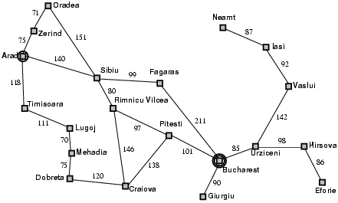
Popular AI Search Problems
Classic AI search problems, Map searching (navigation)

Slide 70
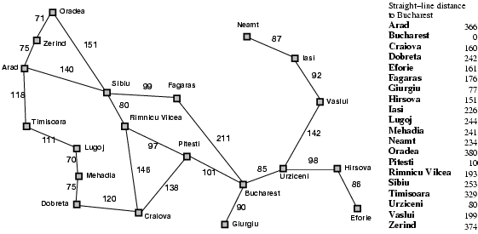
Romania with step costs in km

Slide 71
A* search
Idea: avoid expanding paths that are already expensive
Evaluation function f(n) = g(n) + h(n)
g(n) = cost so far to reach n
h(n) = estimated cost from n to goal
f(n) = estimated total cost of path through n to goal

Slide 72

A* search example

Slide 73
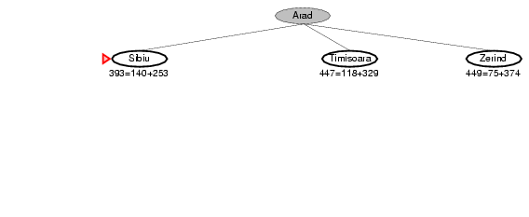
A* search example

Slide 74
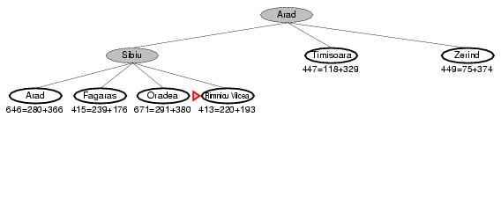
A* search example

Slide 75
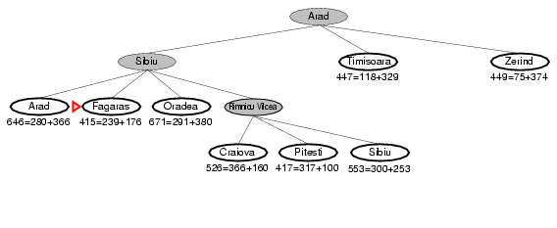
A* search example

Slide 76
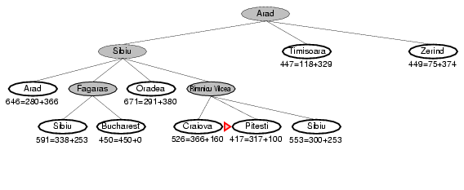
A* search example

Slide 77
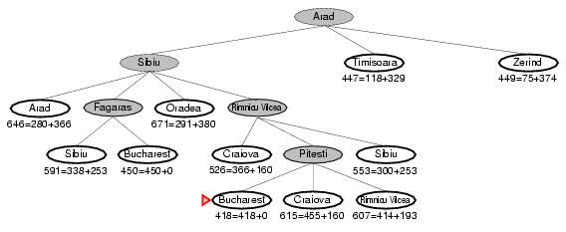
A* search example

Slide 78
But what is a good heuristic?

Slide 79
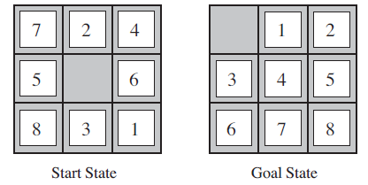
8-puzzle problem

Slide 80
Heuristic 1: Misplaced Tiles
h(n) = number of tiles that are out of position in state/node n
For the start state h(n) = 8 as all tiles are out of position in comparison to the goal
Following a best first search procedure, expanding the start state, we will get 4 newer states.
Calculate value of h(n) for each state and expand the state with the least value of h(n) i.e. the best state
Continue same process until we reach goal state

Slide 81
Heuristic 2: Manhattan Distance
h(n) = sum of the distances of the tiles from their current position to the goal positions for a state n
For the start state h(n) = 3 + 1 + 2 + 2+ 2 + 3 + 3 + 2 = 18 [Remember that tiles can only move in right angles i.e. either vertically or horizontally]
Following a best first search procedure, expanding the start state, we will get 4 newer states.
Calculate value of h(n) for each state and expand the state with the least value of h(n) i.e. the best state
Continue same process until we reach goal state

Slide 82
Heuristic Dominance
Total Misplaced tiles, h1 = 8
Total Manhattan distance, h2 = 18
Now if both h1(n) and h2(n) are admissible and h2(n) ≥ h1(n) for all nodes n, then we say h2(n) dominates h1(n).
h2(n) will be better for search and will search less nodes than h1(n)
If there are several admissible heuristic, the one with highest value should be chosen
The estimated cost, h (n) should be made as large as possible without exceeding the actual cost, h*(n)

Slide 83
How to choose an admissible heuristic?

Slide 84
Generate an Admissible Heuristic by Constraint Relaxation
Identify the preconditions or constraints
Create relaxed problems by dropping the preconditions or constraints
Solve the relaxed problems without searching
An optimal solution of a relaxed problem will be an admissible heuristic for the original problem.
Let us understand this with the help of the 8 puzzle problem

Slide 85
Generate an Admissible Heuristic by Constraint Relaxation
Let us Keep precondition/ constraint (I), (II) and drop (III) :
A newer relaxed version of the problem is thus created
A tile will be placed initially in a specific cell and any tile can move either vertically or horizontally without taking into account whether destination cell or any cell in between is empty
An optimum solution can be found by calculating the shortest path between the initial position and the goal positions for each tile
This solution is exactly the same as Manhattan Distance heuristic.

Slide 86
Properties of A*
Complete? Yes (unless there are infinitely many nodes with f ≤ f(G) )
Time? Depends on the quality of heuristic but still exponential.
Space? Keeps all nodes in memory. A* has worst case O(b^{d}) space complexity
Optimal? Yes

